Slide 1


The innovation hub
DESIGN THINKING AND IDEA LABORATORY
GROUP NO. 14
Group no .14
THE INNOVATION HUB

Slide 2
Progress partners
PROJECT : Medicine tracking and distribution system
MEMBERS :
1. Supriya Gawali [ leader] 2. Sanika Kalwaghe 3.Samruddh Shelke 4.Tejas Avhad 5.Vishnu Verma

Slide 3
Clear definition of topic
A Medicine Tracking and Distribution System is a digital tool used to monitor and manage the flow of medicines from manufacturers to pharmacies or hospitals. It tracks inventory, ensures timely delivery, verifies authenticity to prevent counterfeit drugs, and helps maintain compliance with regulations. The system ensures that safe and verified medicines reach patients efficiently.
Importance of topic
The Medicine Tracking and Distribution System is important because it ensures medicines are delivered safely, efficiently, and on time. It helps prevent counterfeit drugs, reduces errors in the supply chain, and ensures that medicines are always available when needed. This system also helps maintain regulatory compliance, keeping patients safe and ensuring they receive the correct, high-quality medications.

Slide 4
Persona constructing
Constructing a persona involves creating a detailed, fictional representation of a target audience, typically used in marketing, product design, or product development. A persona embodies the background, motivation, challenges faced, doubts and fears and aspirations of a specific group of people, helping you design better solutions.
Why persona is important ?
Personas are used to targeting market audience mins end users,focuses on their day to day life problems and design for that

Slide 5
Persona 1: for patient
MOTIVATION
Motivated by family and relatives
positive Feedback From others
Spending more time with family members
Achieving a better quality of life
Gaining confidence
BACKGROUND
Belong to middle class family
He lives in a join family in Pune
He has a two children's
He is a school teacher working in government school
He is diagnosed with diabetes
DOUBTS AND FEARS
Doubts about will their treatment effective or not
Doubts about will their illness be cured or not
Whether they can pay for hospital charges or not
Fear of being a burden on family
Will their healthcare providers are experienced or not
Fear about not achieving health goals
CHALLENGES FACED
Financial stress due to ongoing condition
Balancing work and health needs.
Disrupted Schedule
limited Understanding of disease
Adapting to lifecycle changes
follows the prescribed diet, especially with Family meals and social gathering
Forgets to take medicines on time.
ASPIRATIONS
Mentally and physically stable life
Want to make personal fulfillment
continues personal growth and learning
reduce the dependency on medicines
Summary
Amit belongs to middle class family he is diagnosed with diabetes working in a government school as a physics teacher . he facing challenges like financial , how to balance professional and personal life but he always motivated but he always motivated by positive feedback of family members .But sometimes doubts about will their illness be cured or not .Amit want reduce the dependency on medicines and wants healthy life

Slide 6
Persona 2: for healthcare provider
Motivation
Their ethics and goals
Their passion in their career
To attain High status in society
Background
He belongs to join family and live in Hyderabad
He has two daughters
He is well educated in medical site
He has high clinical experience in government hospital
He has great experience in balancing personal and professional life
DOUBTS AND FEARS
fear of incomplete knowledge, education as well as skills
Doubts on their own decision in critical conditions
fear of patient does not follow treatment
will their treatment effective or not
Challenges faced
Managing large number of patients
Handling high pressure situations mins emergency conditions
Lack of technological things
Team coordination
Surviving in the race with others
Workload, overwork stress
Shortage of workers
Aspirations
Respect from society
Professional growth and experience
Stable future as well as carrier
Improving public health
Summary
Rahul live in join family in Hyderabad .he is well educated .he was two daughters .he has a high clinical experience but sometimes he faces challenges like how to handle or to stay stable in critical conitions also sometimes he have doubt that their treatment will effective or not also he give high quality treatment to patient ..he wants stable future….

Slide 7
Problem statement and solution
.➱Access to essential medicines in public areas like airports ,railway stations, and malls is often limited especially during emergencies or odd hours .Traditional pharmacies may not be open 24/7,causing inconvenience for travelers and the public needing quick remedies for sudden health issues. Long queues and distant locations add to the difficulty . A medicine ATM could provide immediate ,safe and convenient access to over the counter medicines and basic health supplies anytime ,anywhere

Slide 8
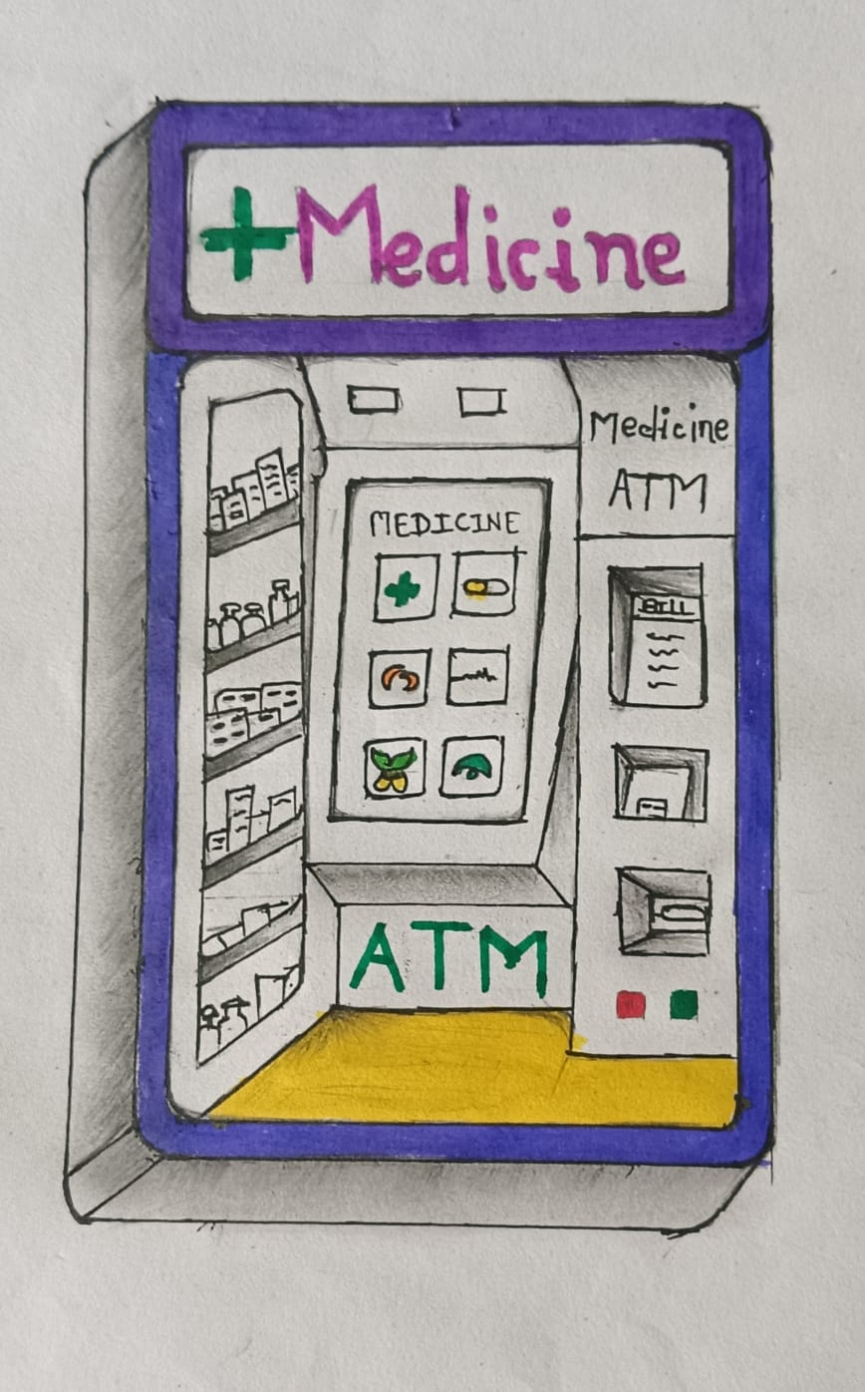
visualization
Scope:
The automated tracking machine should user friendly
With easy UI.. Touch screen helps to better understanding like smartphones . Sufficient to fulfil day to day life medicine needs..
Outcome:
The successful implementation of this automated medicine tracking machine will lead to reduced lack of distribution in emergency conditions , more efficient , and a more convenient user experience, ultimately contributing to a more sustainable lifestyle.

Slide 9
Mind mapping
Why mind mapping is important ?
Mind mapping is a visual tool that helps in organizing and representing information around a central concept. It involves creating a diagram that uses branches to represent ideas and sub-ideas, making it easier to visualize connections and relationships between different pieces of information. This technique is often used in note-taking, problem-solving, and planning.

Slide 10
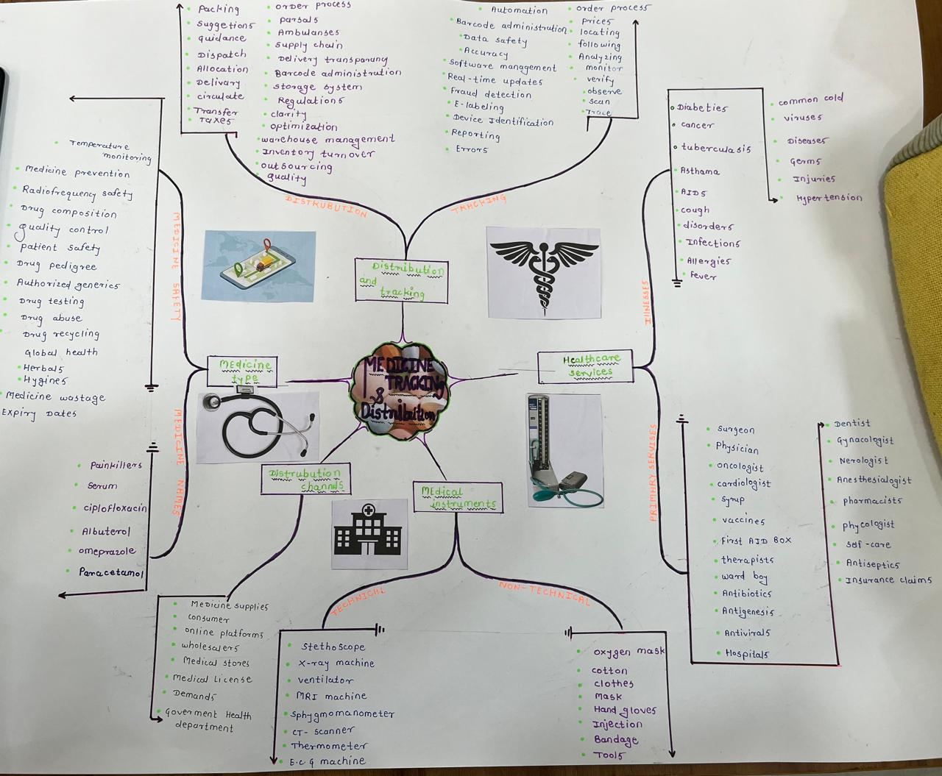
mind map for medicine tracking and distribution

Slide 11
5W 1H matrix
QUESTIONS/CHATEGARIES | DISTRIBUTION AND TRACKING | MEDICINE TYPE | HEALTHCARE SERVICES
WHEN | When should we replace or restock expired medicines. | When should I take this medicine, before or after meals? | When should a patient seek emergency healthcare services?
WHERE | Where are the medicines are stored before distribution | Where can I find information about the different types of medicine available? | Where can patients find information about available healthcare services in their area?
WHOM | Whom should we assign for tracking and deliveries | Whom should I consult before starting a new type of medicine? | Whom should patients contact to schedule a healthcare service appointment?
WHAT | What tools can help in tracking medicine | What types of medicines are available in market | What types of healthcare services are available
WHY | Why is important to track the medicine | Why was this type of medicine prescribed for my condition? | Why are healthcare services essential for public health?
HOW | How we can identify the expire medicine | How does this type of medicine work in the body? | How do healthcare services differ between urban and rural areas?

Slide 12
reference
Healthcare providers (family doctors , relatives working in healthcare services )
Healthcare centers
patients

Slide 13
Thank you !

